Slide 1

INDIAN SOCIETY FOR TECHNICAL EDUCATION
An Intro to CSS Grid

Slide 2
What even is CSS Grid?
Introduced in 2012 in CSS3.
Allows building complex designs on web with relative ease.
Allows building layouts that would otherwise be impossible or very hard to build with older css technologies like flexbox and tables.
Widely supported (95% of all web browsers support it as of May 2020)*.
* Source: https://caniuse.com/#feat=css-grid

Slide 3
But What Can I Do with CSS Grid?

Slide 4

credits: grid-masterclass.webflow.io

Slide 5
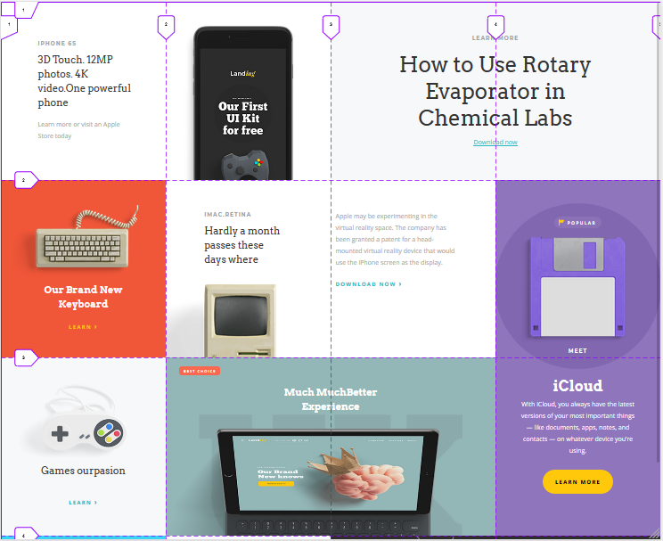
credits: grid-masterclass.webflow.io

Slide 6
One More…

Slide 7
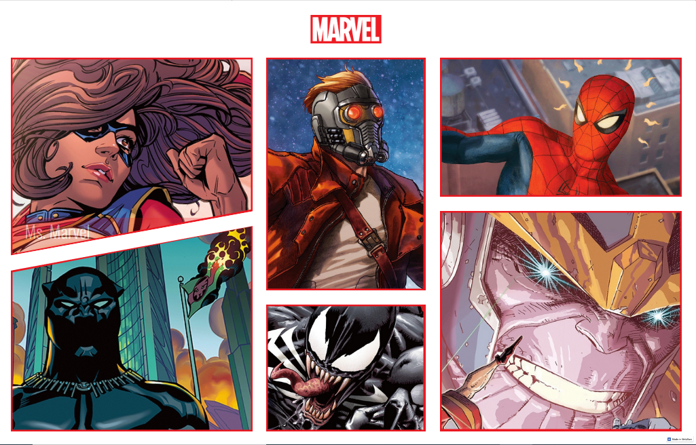
Credits: marvel-grid.webflow.io

Slide 8

Credits: marvel-grid.webflow.io

Slide 9
Another Example…
No more pictures!
Let’s visit this one on firefox:
https://redonion.se/cssgrid/

Slide 10
What’s wrong with Flexbox and Bootstrap Grid?
Both are excellent technologies and were technological breakthroughs when they came out.
They are still suited for grids and arrangements where there are objects of fixed or similar height.
But when you are working with 2-Dimensional layouts, css grid is about as great as it gets.
Also if you are only using bootstrap for its grid, you are probably importing a lot of unused code too which will slow your website down in areas of poor connectivity.

Slide 11

Flexbox and Bootstrap are Suited for Items of Same Height

Slide 12
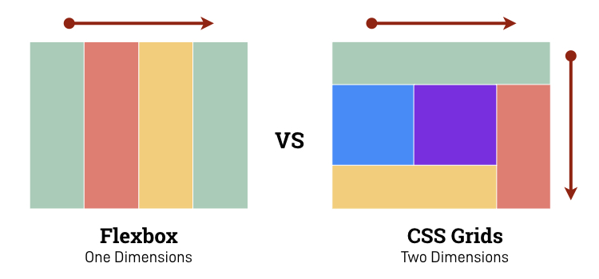
Source:https://softtechgroup.us/blog/techhub/flexbox-vs-css-grid

Slide 13
What Do We Need?
Code editor ( recommended: VS Code )
Web Browser (Chrome and Firefox)
Emmet Abbreviation (optional but recommended)
Coding extensions:
SASS Compiler (optional but recommended)
Live Server (optional)
Static Assets (github.com/iste-vit/css-grid)

Slide 14
A Basic Grid

Slide 15
How to Make the Grid
Columns
1
2
3
1
2
Rows
3
This separator is not part of the final grid but its needed for atomization of the grid and to make individual cells. We can just say that the big div SPANS two cells.

Slide 16
You can specify component by AREA
This is the basic idea behind implicit system
You can specify components by PERIMETER
This is the basic idea behind explicit system

Slide 17
The Two Ways to Grid
Implicit
Explicit
Specify grid layout by giving names to the parts of grid
Easier to do.
For simpler grid use cases.
Specify grid layout by specifying starting and ending points of the grid elements.
Relatively harder to do.
Suited for more complex use cases.

Slide 18
Everything you can do with the implicit system can be done with the explicit system too.
But not everything you can do in the explicit system can always be done with the implicit system. Explicit system basically has more precision.

Slide 19


Slide 20
OK! Enough Talking, Lets Code.

Slide 21
What’s Next?

Slide 22
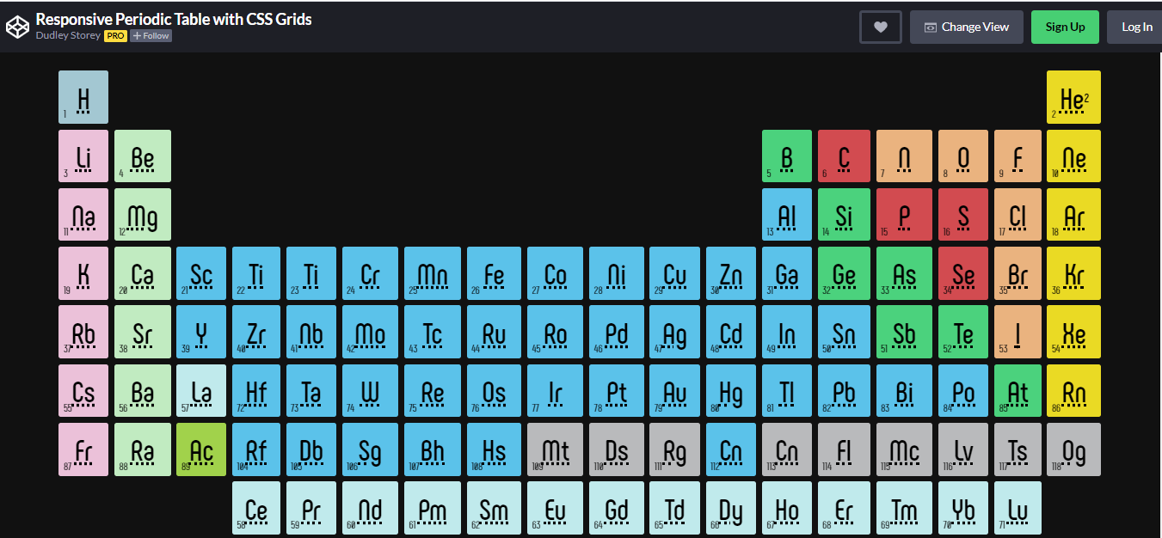
Cool Projects to Master CSS Grid
Source: https://codepen.io/dudleystorey/full/rmWMXY/

Slide 23
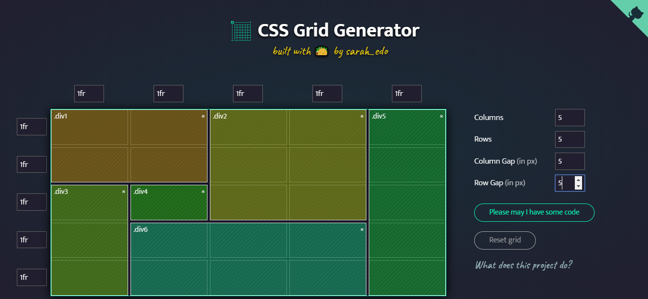
Cool Projects to Master CSS Grid
Source: https://cssgrid-generator.netlify.app/

Slide 24

grid
grid

Slide 25
Thank You!

Slide 26

Indian Society For Technical Education
istevit.in
instagram.com/iste_vit_vellore
facebook.com/ISTE.VIT
linkedin.com/company/indian-society-for-technical-education
github.com/ISTE-VIT
About Me
Vaibhav Chopra
github.com/sudo-vaibhav
linkedin.com/in/vaibhav-chopra-730b5318b

